Slide 1

ANALYSIS OF THE PLAY STORE APPS
MSIS 642 FINAL PROJECT
By (Group 13)
-DhanaLaxmi Nayak
-Kumar Saurav Dash

Slide 2
OUTLINE
The project is modelled on the data set consisting records based on different play store apps.
It focuses on the effects that different aspects have on the number of installs of a particular app.
Our target variable is “Installs” (number of installation).

Slide 3
MOTIVATION
Android and iOS app revenue reached $111 billion revenue in 2020, a 24 percent increase year-on-year.
For any app to be launched on this particular platform, there should be a better understanding of the different aspects that are associated with the launch
We study the effects of attributes like installs, ratings on our data set and the findings can thus be utilized for new product launch

Slide 4
LITERATURE REVIEW
We have referred different papers that are previously based on their work around different aspects of google play store
Analysis of Google Play Store Data set and predict the popularity of an app on Google Play Store
https://www.researchgate.net/publication/343769728_Analysis_of_Google_Play_Store_Data_set_and_predict_the_popularity_of_an_app_on_Google_Play_Store
This journal also gives detailed information on feature extraction and the complete Data visualization done on this data set.

Slide 5
LITERATURE REVIEW
Another paper that was taken into consideration: https://www.pewresearch.org/internet/2015/11/10/an-analysis-of-apps-in-the-google-play-store/
This particular study focusses mainly on keyword analysis has taken place to find the important words used in the app title that results in higher and lower ratings.

Slide 6
THEORY AND HYPOTHESES
Hypotheses based on previous research
Based on improving developer and user experiences and keyword analysis of important keywords effecting the ratings of an app
Research question: How do different factors/attributes have significant effect on the number of installs of a particular app on google play store?
H0: There are no relationships between the factors
Ha: There are relationships between the factors

Slide 7

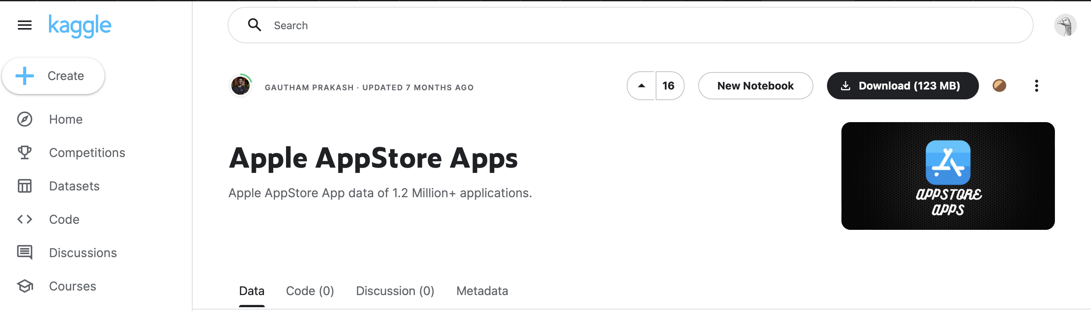
ABOUT THE DATA
The data was collected from Kaggle.com
Dependent Variable: 1(Installs)
Independent Variables: 4(Rating, Reviews, Size, Price)

Slide 8
Data Cleaning
We dropped all the observations with missing values that corresponded to less than 1% of the data
Loading data using read.csv(“playstore_data”) and omitting the values with NA and “Varies with Device”.
We dropped app names, current version, and android version column because the data is messy and we find this information not so useful.
Removed the “+” and “,” from target variable (Installs) and changed it to numeric.
Converted the Size in Kilobytes to Megabytes, dividing its value by 1024 and removed “M” and “k” to make the column numeric.
Changed the Price to numeric by removing the dollar ($) sign from all row values.

Slide 9
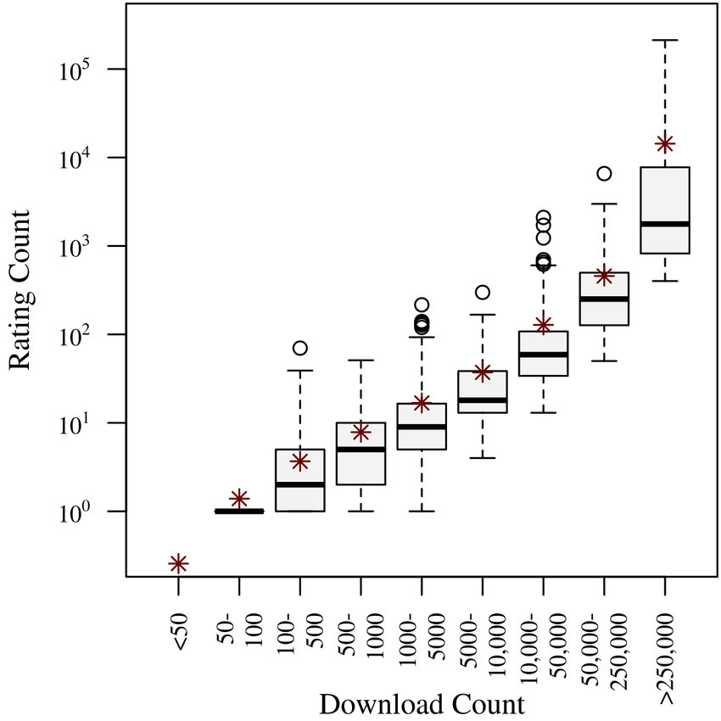
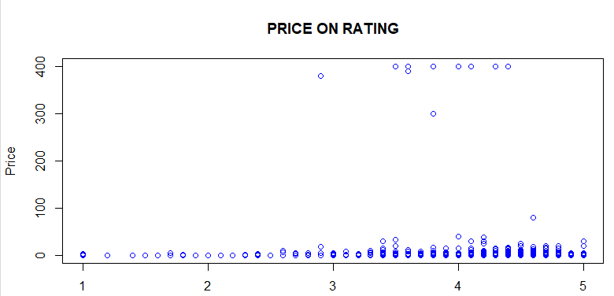
DATA VISUALISATION
Boxplot for Rating
Scatterplot
for Price and Rating

Slide 10
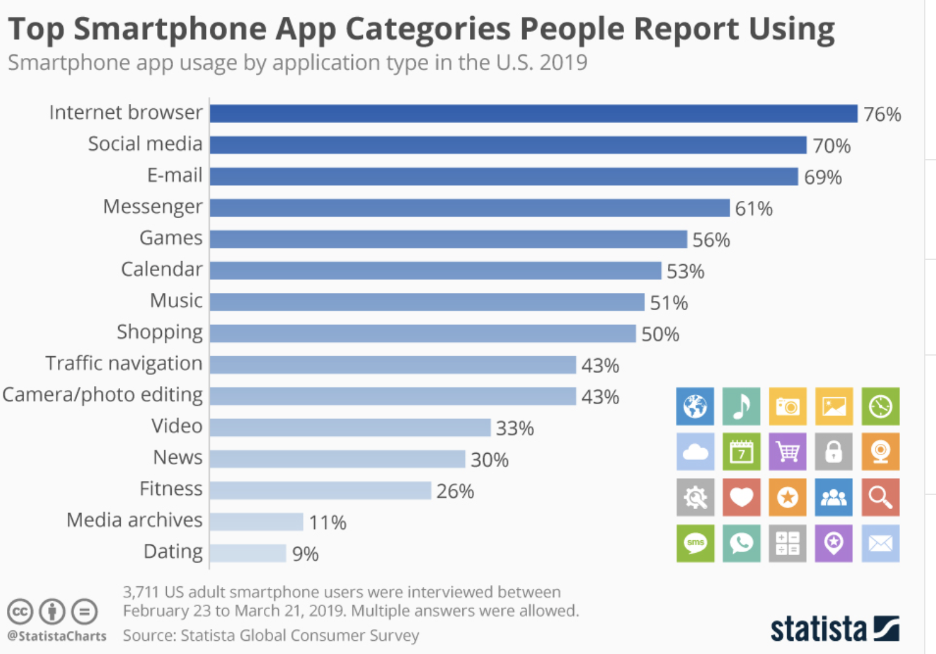
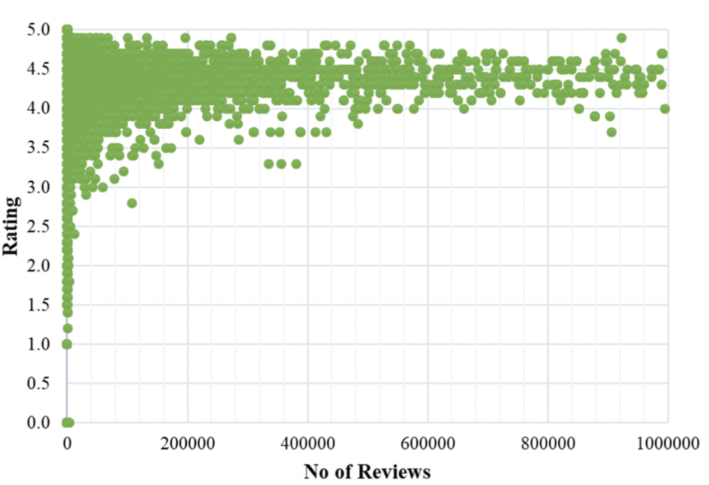
How many apps included in each category?
Rating vs No of Reviews

Slide 11
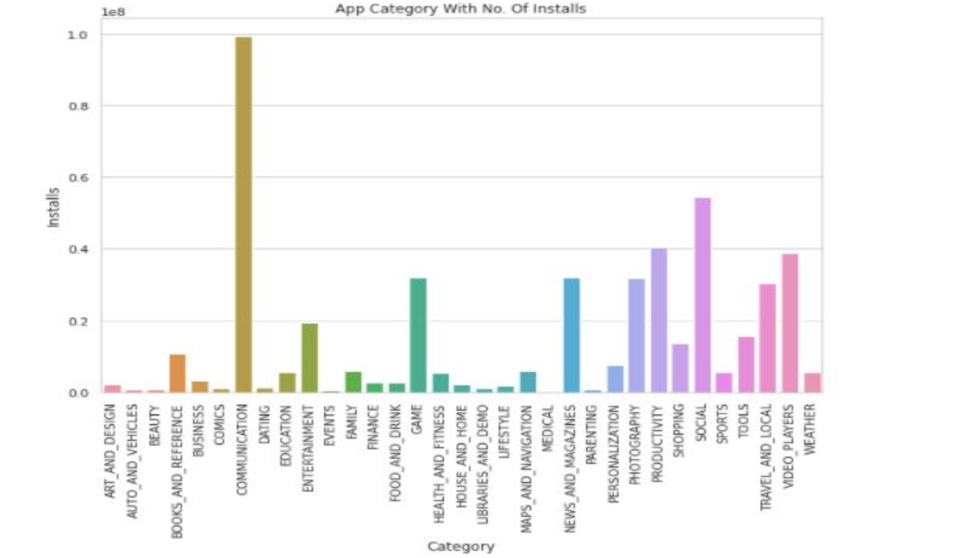
Most Popular Category By number of Installs

Slide 12
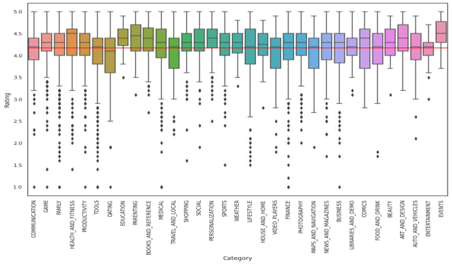
BOX PLOT FOR ALL CATEGORIES

Slide 13
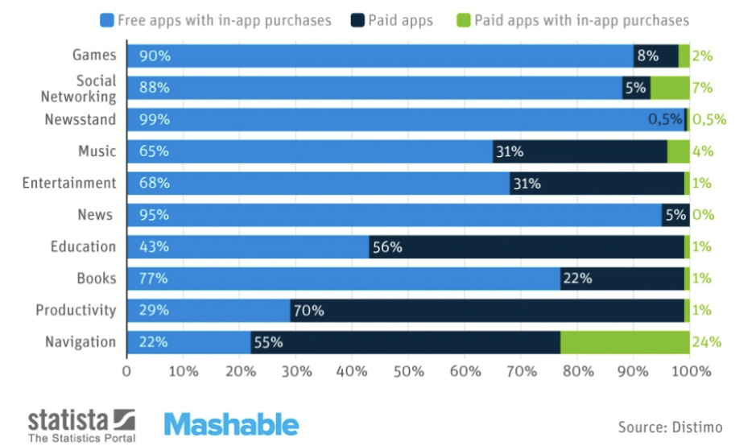
Percentage of Free vs Paid by Category

Slide 14
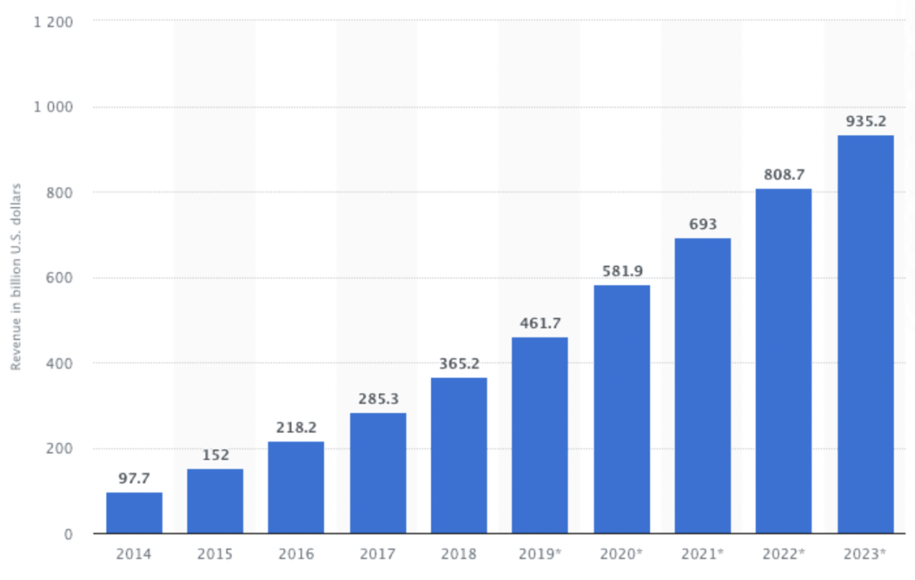
MOBILE APP REVENUES

Slide 15
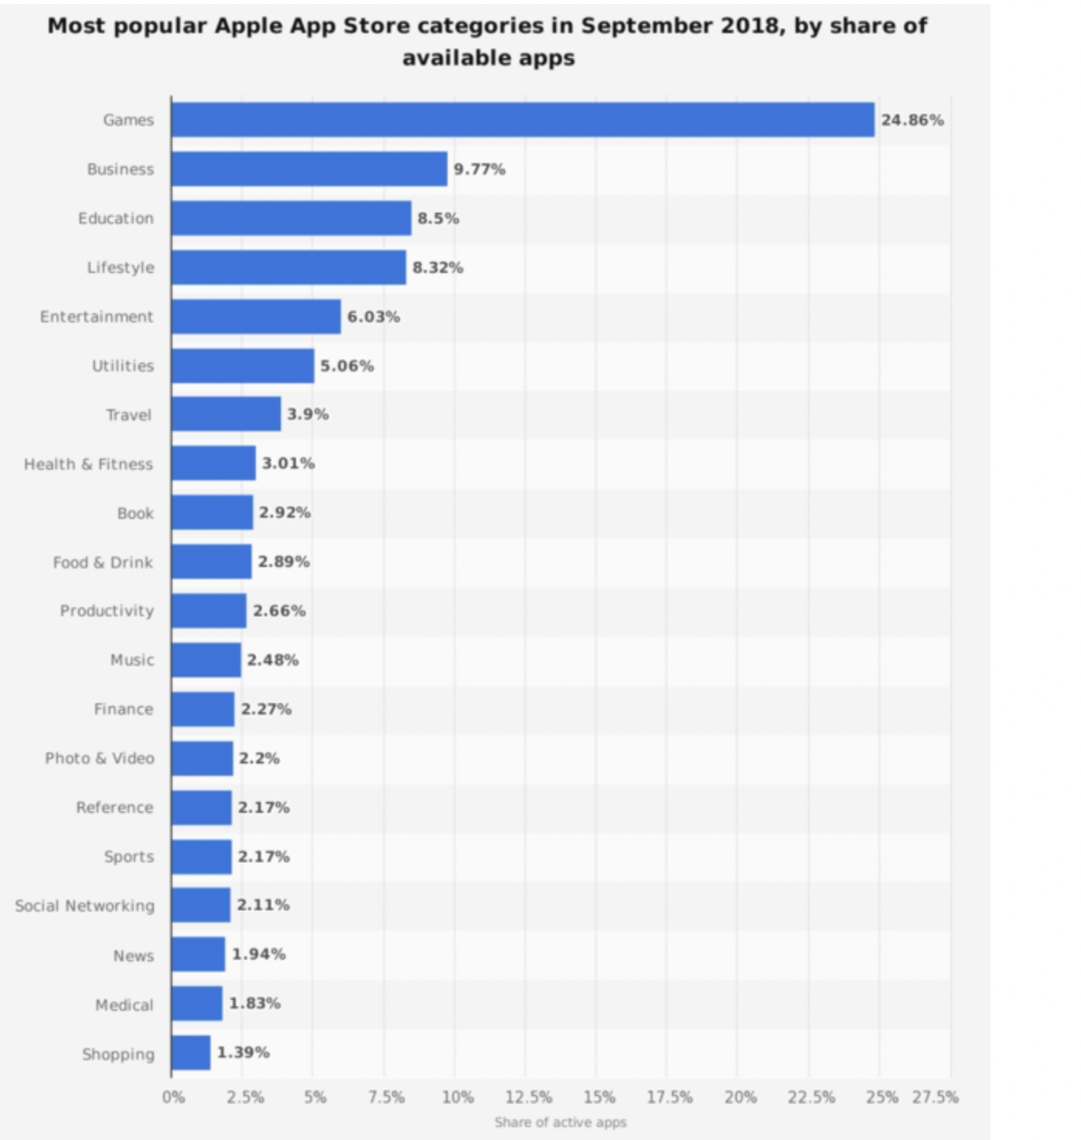
How much money was earned per category?

Slide 16
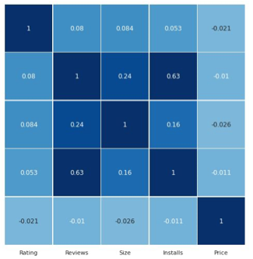
Exploring correlations

Slide 17
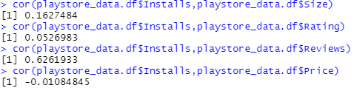
Correlation Coefficient
Checking the initial relationship between independent variables and Installs variable:
Corr (Installs, Size) = 0.1627
Corr(Installs, Rating) = 0.0527
Corr(Installs, Reviews) = 0.6261
Corr(Installs, Price) = -0.0108

Slide 18
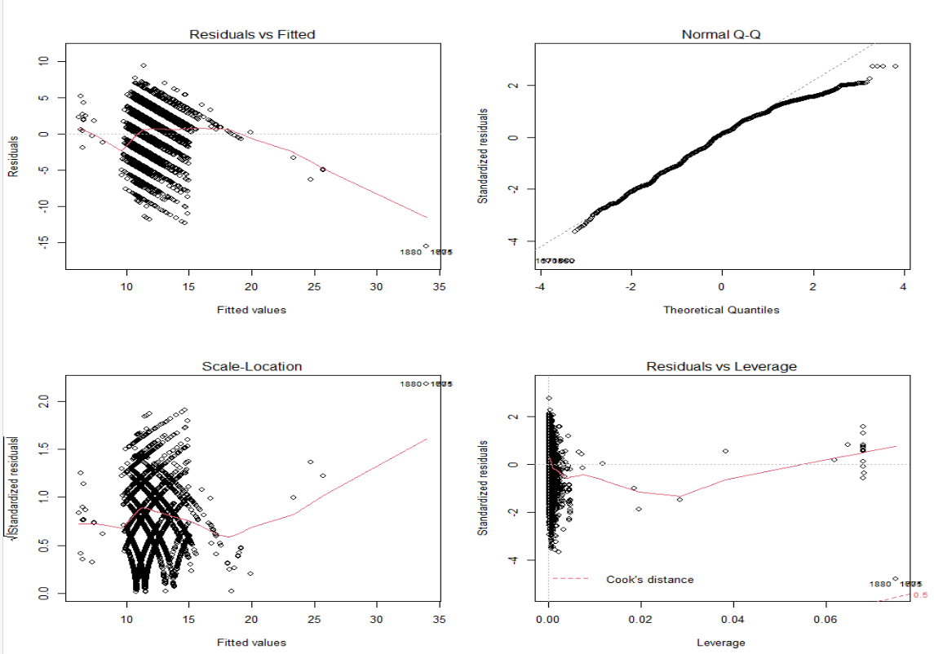
Diagnostic Graphs

Slide 19

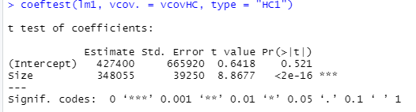

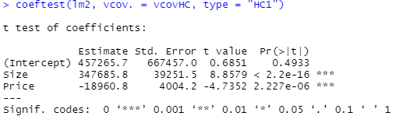
Initial Linear Models

Slide 20

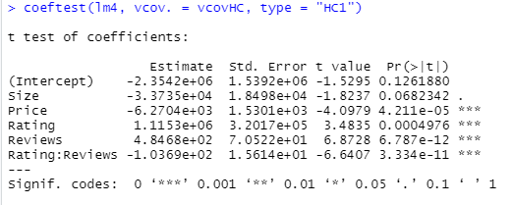
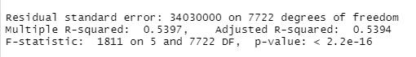
Adding interaction term

Slide 21

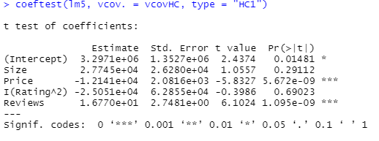

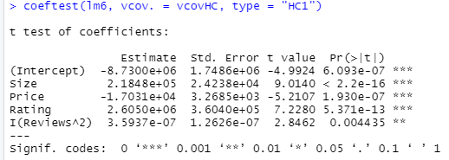
Quadratic Models

Slide 22

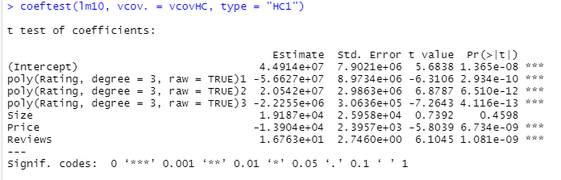
Cubic Model

Slide 23
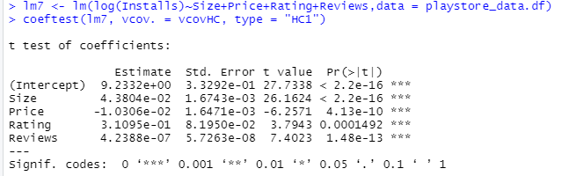
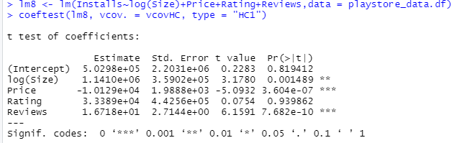
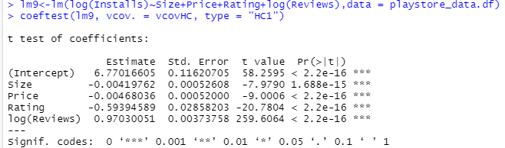
Logarithm Models
Y is log but not X
X is log but not Y
X and Y are in log

Slide 24
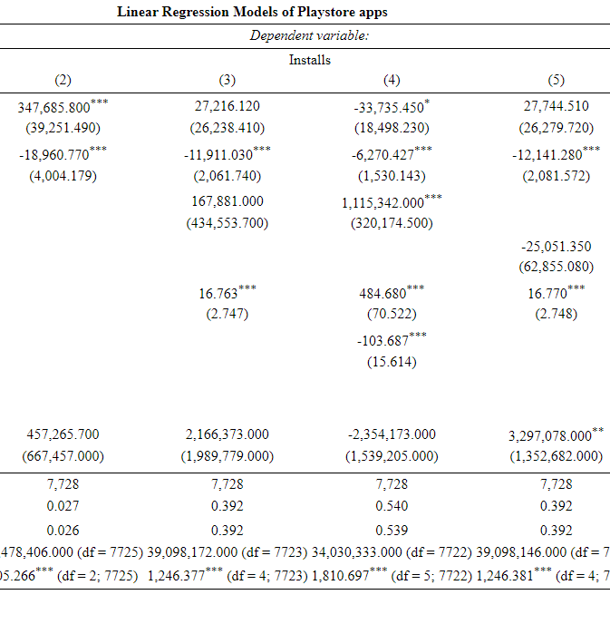
Considering Linear, Quadratic models

Slide 25
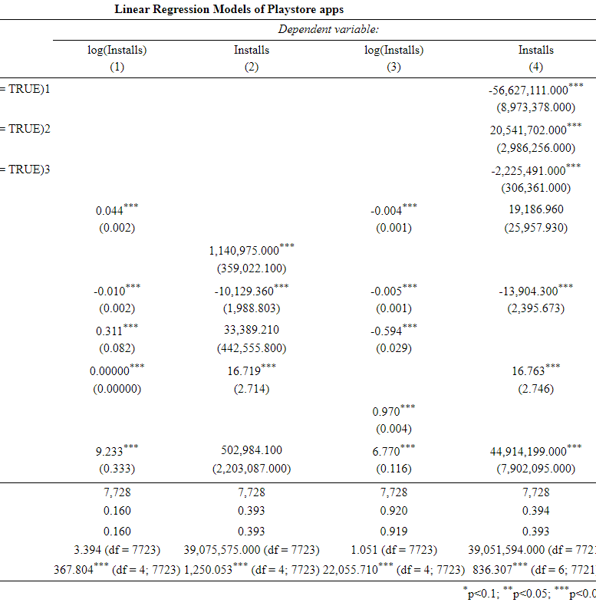
Considering Logarithm models

Slide 26
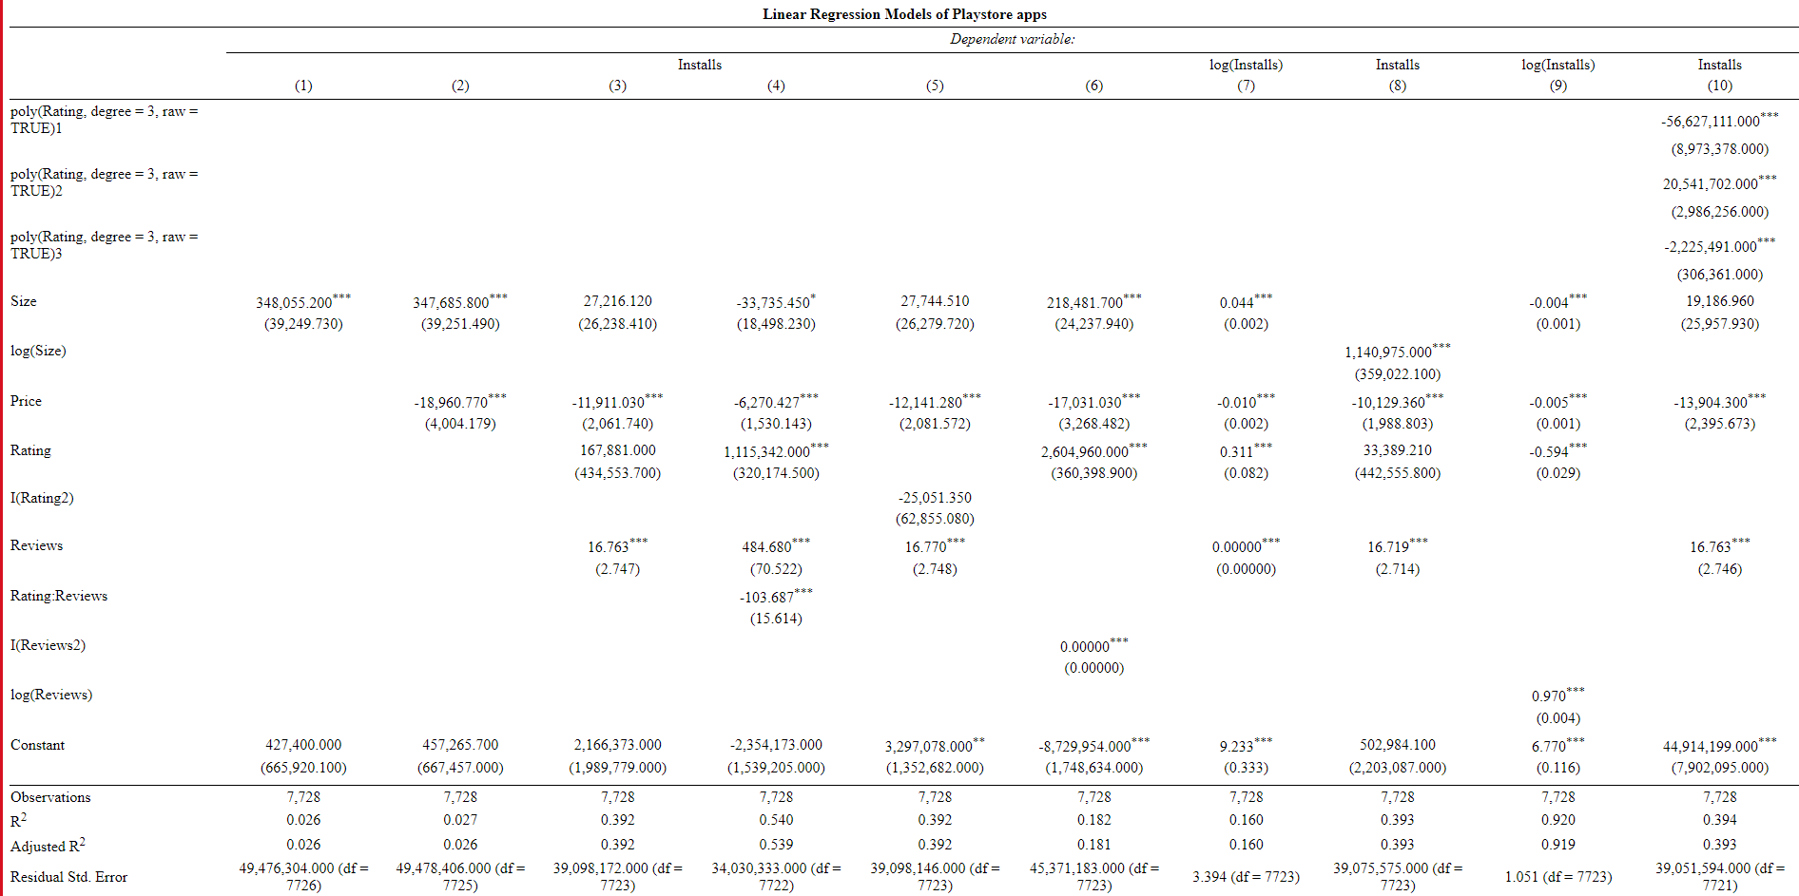
Summary Table of Linear, Quadratic and Logarithm models

Slide 27
Summary-:
ln(installs)= 6.77-0.004*size-0.004*price-0.594*rating+0.97*ln(reviews)
Holding other factors constant, decrease in size by 1 unit will increase the number of installs by 100 * 0.0042 = 0.42%.
Holding other factors constant, decrease in price by 1 unit will increase the number of installs by 100 * 0.0047=0.47%.
Holding other factors constant, 1% increase in reviews is associated with 0.97% increase in number of Installs.
The intercept is the expected mean value of Installs when all factors are 0, therefore it is not meaningful.

Slide 28

Thank You!

